Slide 1
MTA Turnstile Data Analysis By Team JSP: Jhonsen, Sharmila, and Po-Yan

Slide 2
Project Goal
WomenTechWomenYes(WTWY) has a annual gala every summer and would like to leverage data analytics to optimize the placement of their street teams to maximize data collection from the contacts.
Notes:
Our goal is to help WTWY decide at which subway stations in NYC to place canvassers, with the goal of increasing attendance for their summer gala and fundraising

Slide 3
Methodology
Data Sources
Downloaded MTA Turnstile and Income data from relevant sources* for 2018
Grabbed the Median Income for Zip Codes in NYC from Census data for 2017
Get a list of NYC MTA Subway Stations with names and corresponding geocodes
Used Google API to find Zip Codes for the corresponding geocodes
* web.mta.info, American Census data and NYC Transportation Data

Slide 4
Methodology (Cont’d)
Data Cleaning
Formatting
Renamed the columns; striped leading and trailing whitespaces from the column names
Formatted date and time
Used Unit and SCP variables as the key to identify each MTA turnstile data; removed duplicates; sorted the records based on Unit, SCP, Date and Time; computed the delta between the cumulative Entries and Exits
Outliers
Eliminated device counts over 5000 for each turnstile
Removed zeros and negative values from the Entries and Exit counts
Tools
Data Analysis | Data Visualization
Pandas | Seaborn and Matplotlib

Slide 5
Results
Top 10 Subway Stations by annual foot traffic volume for 2018
Monthly pattern (which months are best)
Weekly pattern (which day of the week)
Daily pattern (time)

Slide 6
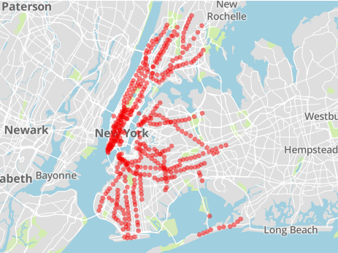



Selecting Best Subway Locations
Subway Stations in NYC
Initial Dataset
(379 stations)
Notes:
Initial datasets include 379 subway stations

Slide 7
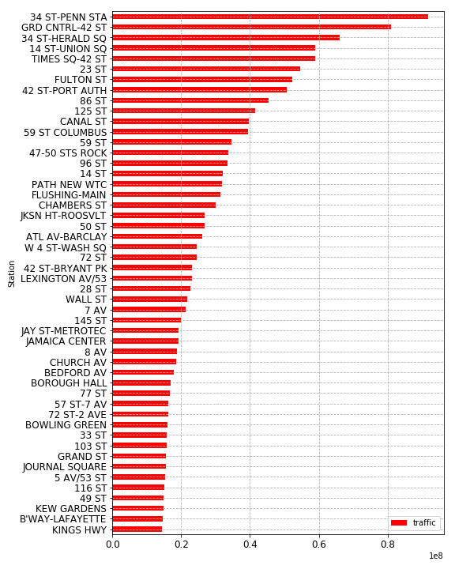
Selecting Best Subway Locations
Based on Entries and Exit Counts “Foot-Traffic”
Volume (x100 mil)
Notes:
We looked at the volume of foot traffic, based on entries and exits counts
We recognized a disproportionate amount of heavy traffic in the top stations

Slide 8
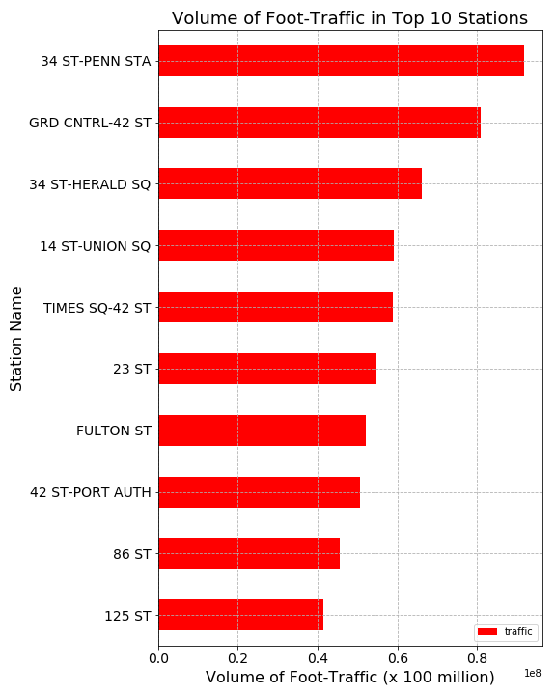
Top 10 Most Busiest Subways
34 St- Penn Station *
Grand Central- 42 Station *
34 St- Herald Station
14 St- Union Square *
Times Square- 42 Station
23 ST *
Fulton ST *
42 St- Port Authority
86 St *
125 St
* Median Income > $100K
Notes:
Identified 10 busiest station; and each have 40 million riders per year
We also identified stations in high-income zipcodes, to target potential “generous” donors at the gala

Slide 9
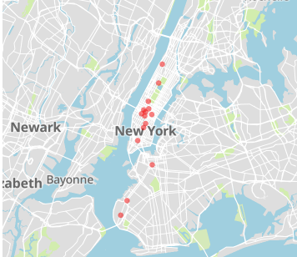
Top 10 Most Busiest Subways
Subway Stations in NYC
Dispersed around different boroughs
Notes:
We hoped that these 10 stations would target diverse set of potential attendees

Slide 10
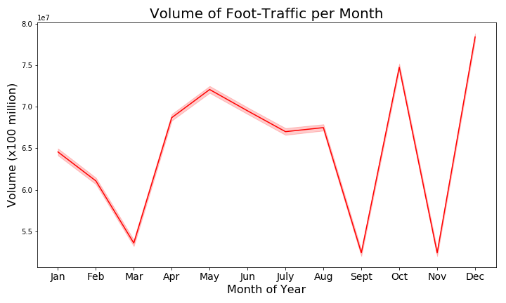
Top 10 by Monthly Foot-Traffic
Notes:
Once we identified focus group (10 stations), we started to look at the ideal months for your street teams to operate
We recognized that April thru August have the heaviest foot-traffic, as indicated by at least 65 million riders in the 10 stations

Slide 11
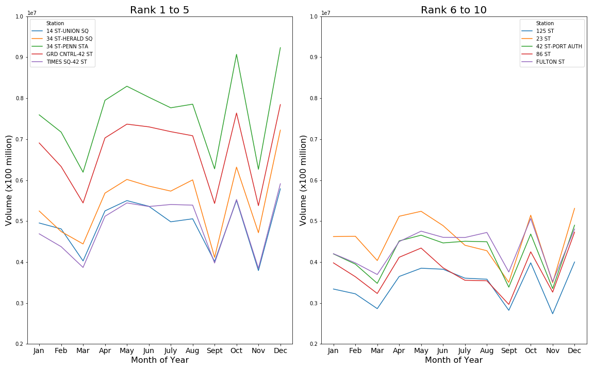
Top 10 by Monthly Foot-Traffic
Notes:
This high-volume pattern seems to be in each of the top 10 stations we focus on

Slide 12
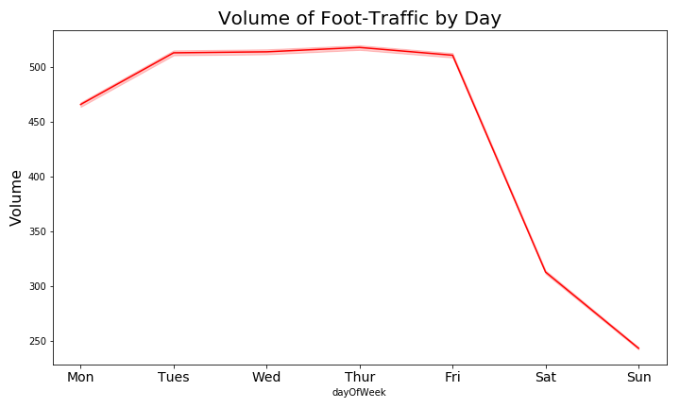
Top 10 by Weekly Foot Traffic
Notes:
We’ve also seen that Mon-Friday have the highest volume of foot traffic, with an average of at least 450 riders across the different stations

Slide 13
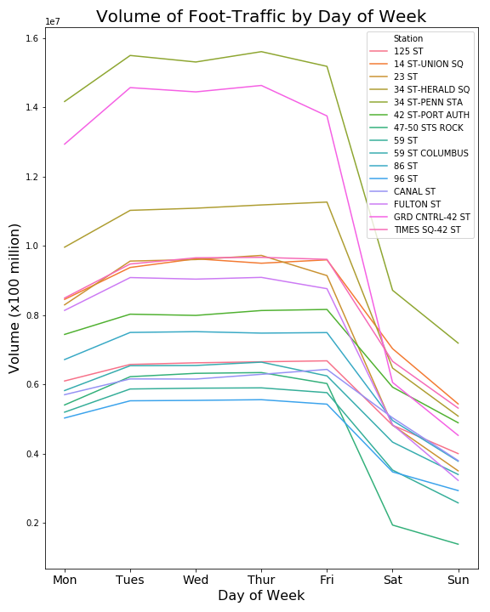
Top 10 by Weekly Foot Traffic
Weekdays are best!
Notes:
The same pattern of high volume of foot-traffic during the weekdays, is also observed in each station

Slide 14
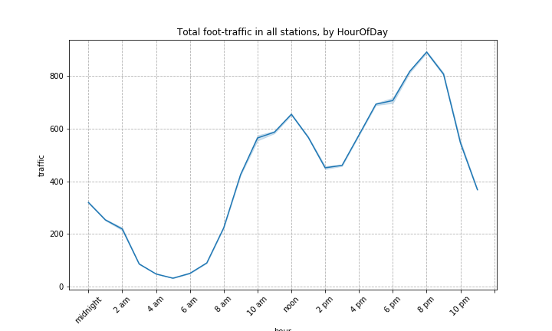
Top 10 by Daily Foot Traffic and Hour
Hour
Notes:
we identified the best hours during the day, with most foot-traffic

Slide 15
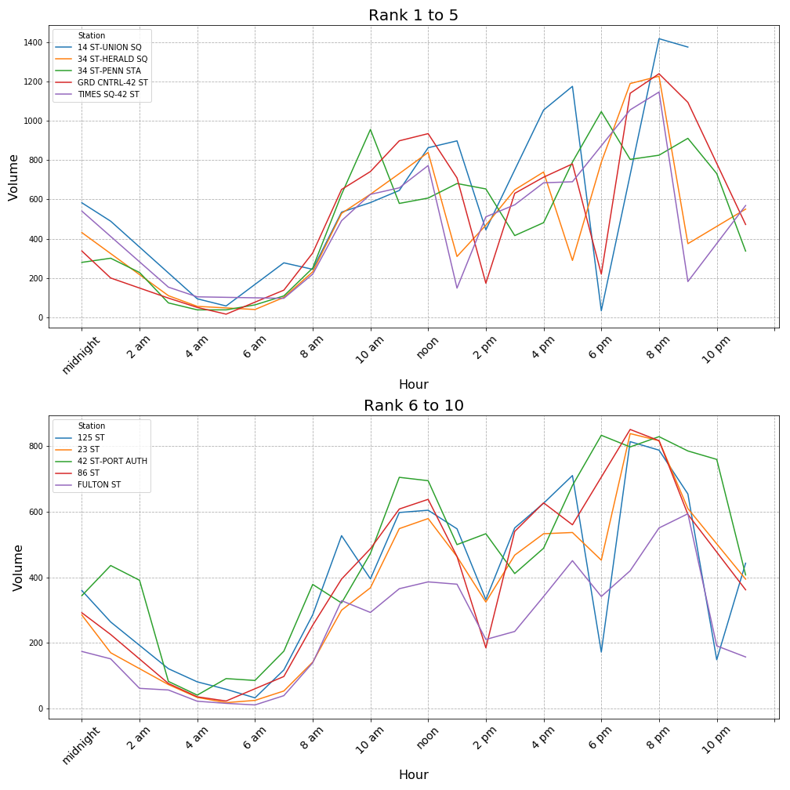
Top 10 by Daily Foot Traffic and Hour
Notes:
Based on this data, we were also able to take a closer look of the behavior for each station,
This allows us to make more precise recommendations regarding the target hours of the day

Slide 16
Recommendation
Station Name | Month | Week | Day/Time
34 St- Penn Station * | April May June | Weekdays | 8am- 11pm
Grand Central- 42 Station * |  |  | 8am- 11pm
34 St- Herald Station |  |  | 8am- 11pm
14 St- Union Square * |  |  | 8am- 1am
Times Square- 42 Station |  |  | 8am- 1am
23 ST * |  |  | 10am-11pm
Fulton ST * |  |  | 4pm- 9pm
42 St- Port Authority |  |  | 8am- 2am
86 St * |  |  | 9am- 11pm
125 St |  |  | 8am - 9pm
* Median Income > $100K

Slide 17
Future Work
More refined data cleaning e.g. better outlier identification per subway station
Expand the MTA data set to include more years into analysis to account for variances
Extra data sources
Consider demographics data such as Education attainment, Industry etc.
Consider Technology companies geographical locations
Align with events targeting Technology and Women

Slide 18
Q & A

Slide 19
Appendix
Data Sources
NYC MTA Turnstile Data - https://www.data.gov
Census Data - https://factfinder.census.gov/faces/nav/jsf/pages/index.xhtml
Subway Station Names and their Geocodes - https://data.cityofnewyork.us/Transportation/Subway-Stations/arq3-7z49

